Slide 1
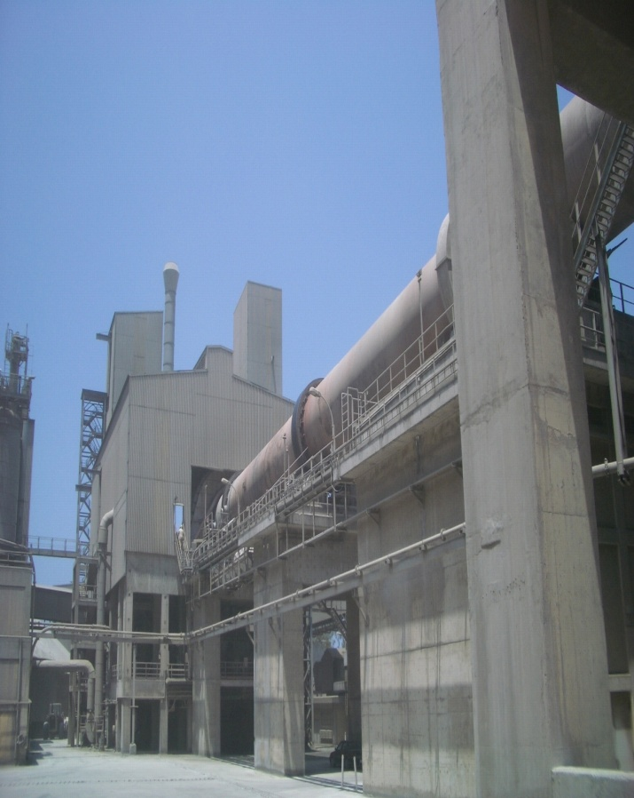
Alternative Fuel Firing Solution
From Testing to confirmation & Application

Slide 2
About Us
We provide tailor-made engineered solutions, products, spares and services.
Founded as an engineering Company in 2005, headquartered in Gurgaon, India, bqb has quickly built a reputation in the cement industry for its innovation, precise engineering and construction work.
With experience in plant operation and system knowhow, bqb has pioneered technologies for optimising entire plants from Raw Material Grinding to Cement Grinding.
In depth process knowhow and a strategic partnership with one of the best in grinding and separation technologists, has put bqb on the global cement map with the references acquired in the last 3 years.
All of bqb’s modification and implementations till date have helped set new efficiency benchmarks for the Industry.
OUR VISION
Help companies achieve sustainability in production processes by applying innovative engineering concepts
Provide high quality engineering services to support the cause of energy reduction in the cement industry while driving higher total efficiency, higher productivity and system availability.

Slide 3
Our Scope
Engineering Consultancy Services for cement and power generation plants.
Alternative fuel firing system - Engineering & equipment supply
NOx and SOx reduction-Technical Audit & Equipment Supply.
Supply of Critical & Non Critical Spare parts
Supply of Grinding Media, Refractory, Consumables
Trained manpower supply
Sourcing of raw material and fuel
Power generation from waste heat
Operation and Maintenance Contracts for Cement Plant
Complete Plant Restoration
Supply of complete cement/lime plant or unit operations
Upgrades and Capacity enhancement
Feasibility Studies
Process Engineering
Plant commissioning
Turn Key Projects.

Slide 4
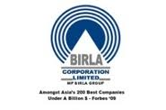








The Company We have worked with
Green Island Cement

Slide 5
AFR Technology
Engineering & Equipment Supply
(Insuring the complete utilization of Alternative fuel (MSW) in Pyro Process in all aspects from environmental to socio-economical)

Slide 6
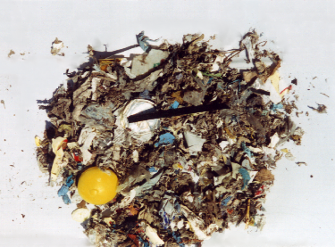
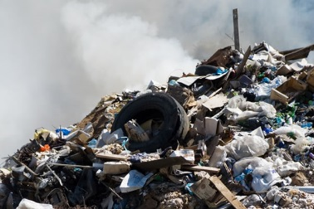
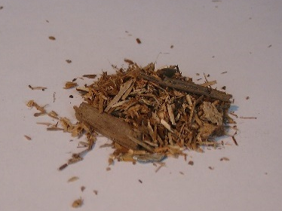
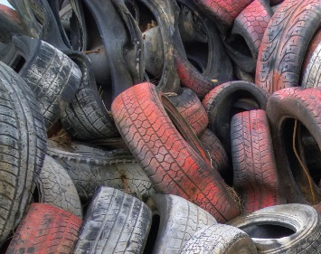
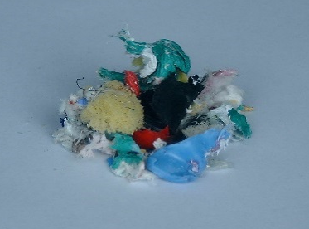
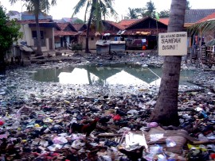
Alternative Fuels For Cement Industry
Waste Oil and solvent
Contaminated wood and process waste from wood
Tyre and Rubber waste
Plastics Waste
Thermal fraction of domestic waste
Thermal fraction of industrial waste
Animal Meal
Sewage sludge
Municipal (Domestic) waste

Slide 7
Advantage of AFR in Cement industry
Counter flow principle
Maintains desired temperature
Long gas residence time
Reduction in CO2
Effective method of achieving lower cost
Safety disposal
Full use of heat content
Full use of mineral content (ASH) of the fuel for raw material substitution
Emissions from cement kiln system are independent of the type of fuel used
No harmful slag
Heavy metals naturally incorporated into clinker
No effluent to be disposed

Slide 8
Calorific and Significant values of Alternative Fuels

Slide 9
Problems of Storage
Organic content
- Odour
- Bacteria/growth of mould
- Development of heat
- Solidification
2. Humidity
3. Jamming
4. Voluminously – big storage space
6. Contamination

Slide 10
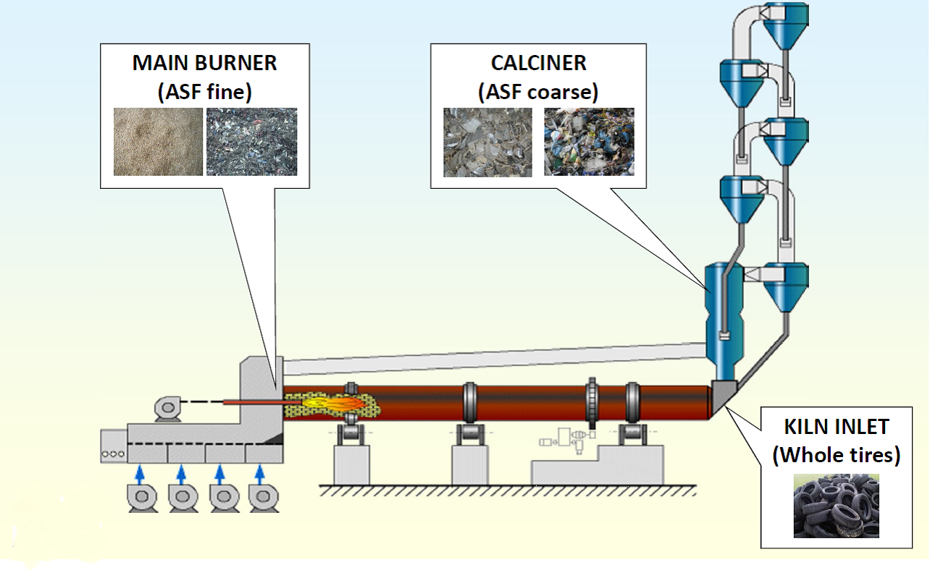
Where to burn Alternative Fuels in a Cement Plant
Wood
Waste Oil
Plastics
Waste oil
Animal Meal
Domestic Waste
Tyres
Rubbers

Slide 11
Important Points for burning
Even particle size distribution
As even as high calorific value
Free affecting content like metals, glass, minerals
Low moisture content
Very low conveying air mass – low cooling of the flame
Speed at the burner end
Low Cl and S content
No harmful components e.g. higher level of heavy metal content
No disturbing materials like metals, glass, stones, etc.

Slide 12
Alternative Fuel Preparation

Slide 13
Preparation Plant for Tyres
Our plant provides following functions:
storage bin for shredded tyres
Photo sensor
Tyre separation line
5 steps
Intermediate storage and conveying of tyres
Scanning and separation
of non suitable tyres
Dosing of tyres and rubber pieces
output
scan conveyor
storage box for complete tyres
Metering conveyor balance
dust binder
Double flap system with Pneumatic flaps

Slide 14
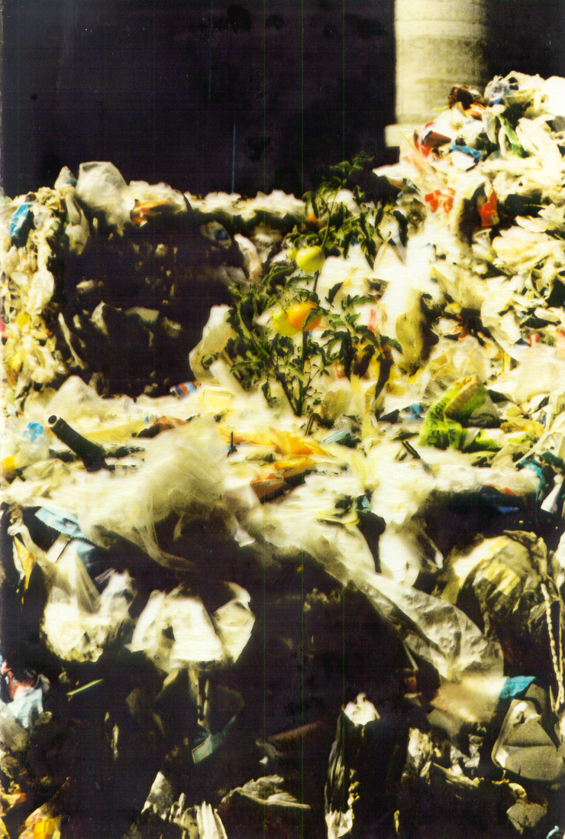
Preparation of plastic and substance mixture
after
before

Slide 15
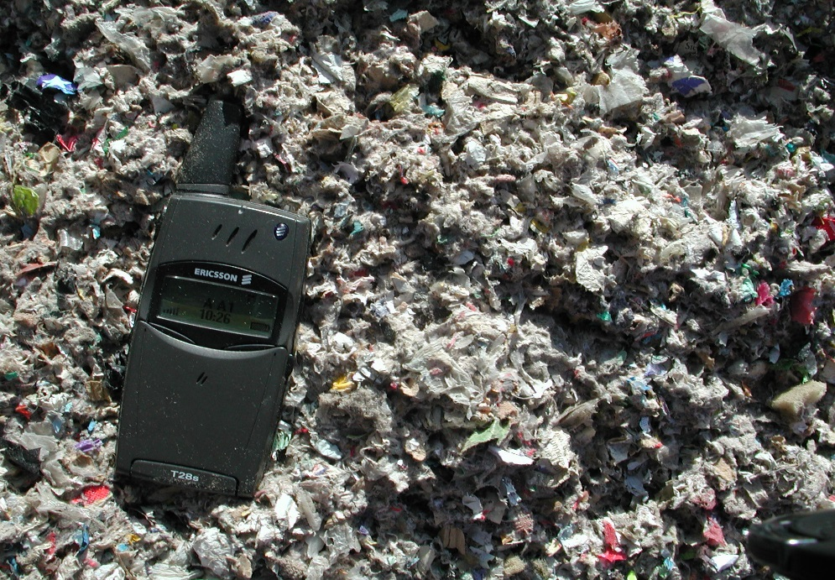
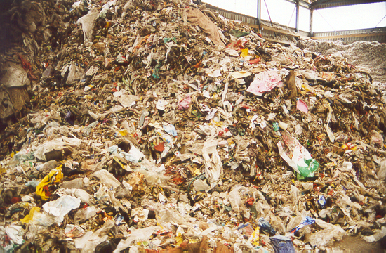
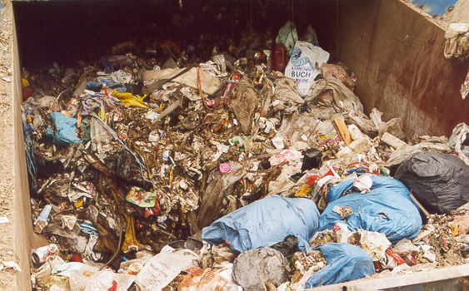
Preparation of domestic waste

Slide 16
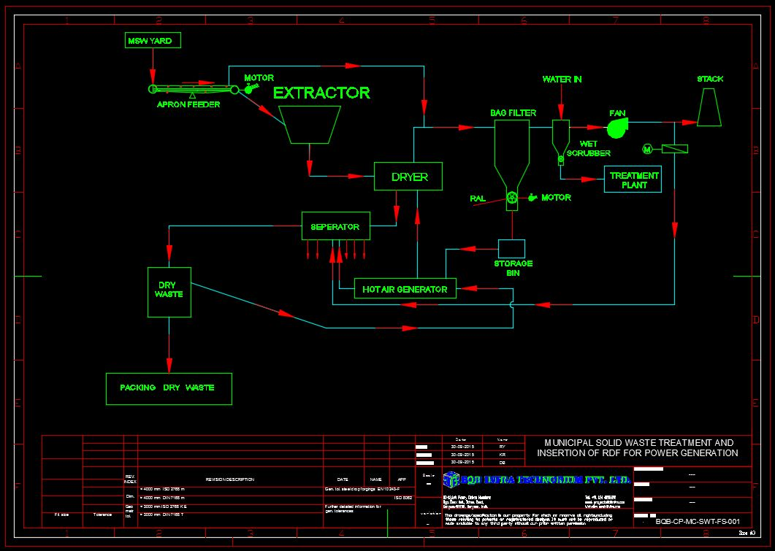
Flow Sheet – Preparation of MSW

Slide 17
Domestic Waste Preparation
Advantage of the process:
CO2 Reduction
Thermal fraction of domestic haste has a high calorific value of 17-21 MJ/Kg
Substitution of conventional fossil fuel
No additional emissions of dangerous component
Utilization of waste heat for drying and stabilization and neutralization of the drying air.

Slide 18
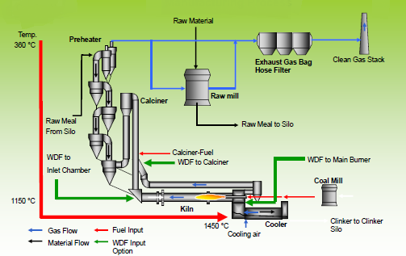
COPROCESSING OF RDF IN CLINKER MANUFACTURING PROCESS

Slide 19
Emission analysis & control
(dioxin/Furan, Sox, NOx and Heavy metals)

Slide 20
Emissions
During RDF combustion, depending upon the waste composition, the exhaust gases contains undesirable constituents like HCl, HF, SO2, NOx, dioxine and furans.
Contains suspended solid particles and condensed metal (Cd, Hg).

Slide 21
Emission Control
Combustion process at high temperature >900 °C prevent formation of Dioxin and furans (0.1 ng TEQ/Nm3).
Injecting the ammonia solution(SNCR System) will reduce the NOx formation into the calciner and converting a calciner into Low Nox Calciner.
Due to alkalinity of the process complete immobilization of Heavy metals in the crystal structure of clinker (except mercury).
Ashes are completely recycled into the product clinker and cement.

Slide 22
Influence on Emission
Legal limits
No Significant Influence!

Slide 23
Influence on Emission

Slide 24
Influence on Clinker

Slide 25
Influence on Clinker

Slide 26

BQB’s Scope in association with
Study the current operation philosophy and assessing the bottlenecks.
Design and installation of Preparation, Handling, Dosing and Feeding Technology.
Validation of quantity of fuel fired per hour to cater the heat requirement
Suggest the location of feeding point of AFR.
Suggestion to control the Emission of gases (CO2, NOx, SOx) and Dioxine and furans.
Suggestion to improve the combustion of fuels in calciner.

Slide 27





Our Associates
EURO KILNS
ALL KIND OF KILN MECH. WORKS

Slide 28
THANK YOU

