Slide 1
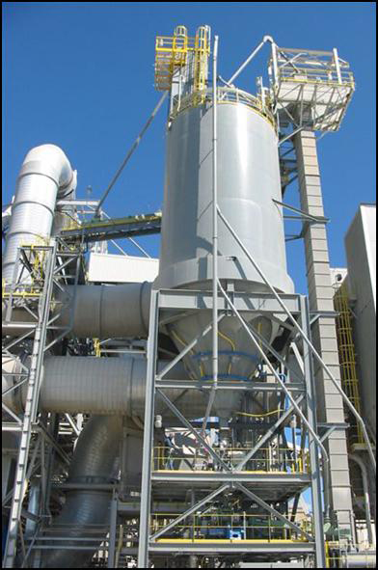
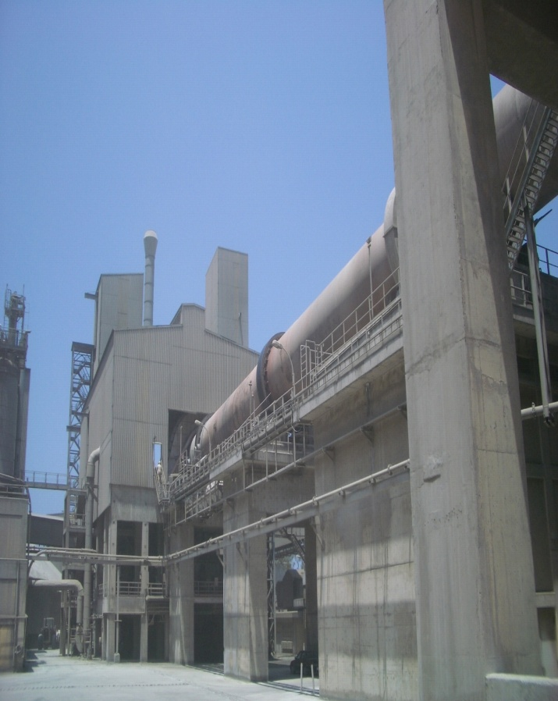
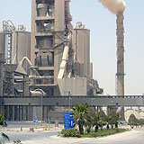
An ISO 9001:2008 Certified Company
Bold Innovation

Slide 2
About Us
We provide tailor-made engineered solutions, products, spares and services.
Founded as an engineering Company in 2005, headquartered in Gurgaon, India, bqb has quickly built a reputation in the cement industry for its innovation, precise engineering and construction work.
With experience in plant operation and system knowhow, bqb has pioneered technologies for optimising entire plants from Raw Material Grinding to Cement Grinding.
In depth process knowhow and a strategic partnership with one of the best in grinding and separation technologists, has put bqb on the global cement map with the references acquired in the last 3 years.
All of bqb’s modification and implementations till date have helped set new efficiency benchmarks for the Industry.
OUR VISION
Help companies achieve sustainability in production processes by applying innovative engineering concepts
Provide high quality engineering services to support the cause of energy reduction in the cement industry while driving higher total efficiency, higher productivity and system availability.

Slide 3
Our Scope
Turn Key Projects
Feasibility Studies
Plant commissioning
Process Engineering
Supply of complete cement/lime plant or unit operations
Operation and Maintenance Contracts for Cement Plant
NOx and SOx reduction-Technical Audit & Equipment Supply
Engineering Consultancy Services for cement and power generation plants
Complete Plant Restoration
Upgrades and Capacity enhancement
Sourcing of raw material and fuel
Power generation from waste heat
Trained manpower supply
Supply of Critical & Non Critical Spare parts
Supply of Grinding Media, Refractory, Consumables

Slide 4
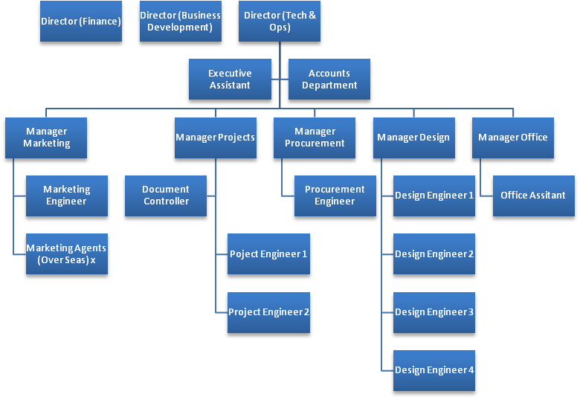
Our Team
Director, Technical & Ops has 30+ years of rich experience in the cement industry and design applications. His experience includes leadership roles in several prestigious organizations
  Senior Consultant | PEG‐SA, Geneva, Switzerland
  Technical Director (APAC) | ATEC
  General Manager (Process Engg) | Enexco, New Delhi, India
  In charge (Process Engg) | Saurashtra Cement, Porbandar, India
  Earliest stint at Andhra Cement
Projects designed and concluded demonstrates innovation and remarkable results. They continue to remain industry benchmarks till date.
The extended bqb team comprises of the following experts
Process and Quality
Operations
Design
Mechanical
Instrumentation
Electrical
Projects
Management

Slide 5









The Company We have worked with
Green Island Cement

Slide 6
Some Of The Work We Do

Slide 7
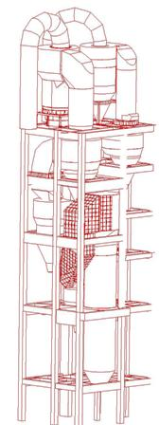
Pyro Modification
LOW PRESSURE tailor made cyclones with vanes
Highlights
Special design features offer maximum separation efficiency
Customised solutions pressure loss
Energy savings with improved GV guide vanes design
Optimised utilisation of the inventory of plant and buildings
Gujarat Siddhi Cement
Top two stages in both strings and calciner
Pressure drop reduced from 750 to 450mmwg
Production increased from 3800 tpd to 4200 tpd

Slide 8
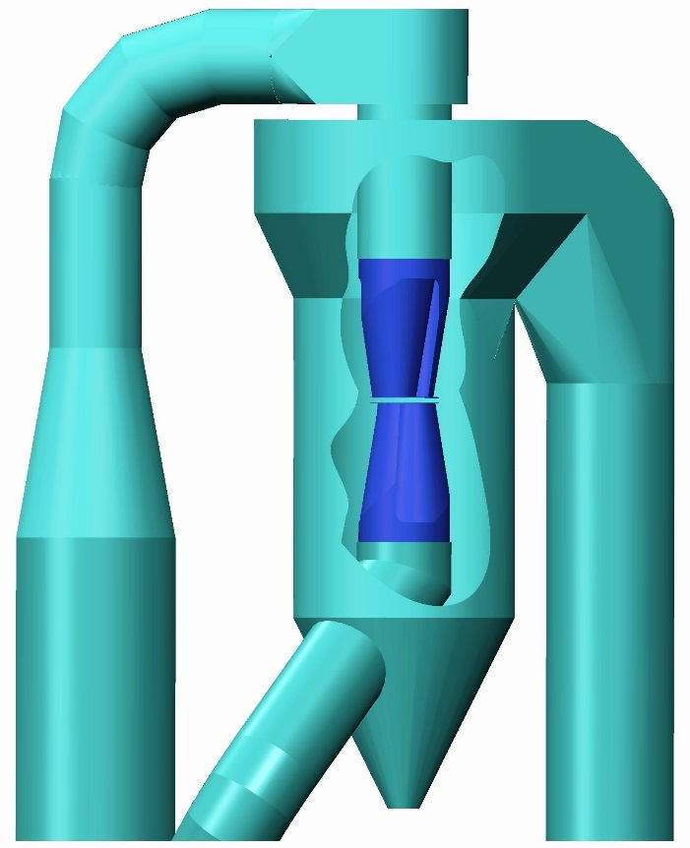
Low Pressure High Efficiency Cyclone
DT Double dip tube cyclone
Applications
Product separation after mills or classifiers
DE dusting of clinker cooler exhaust air
Product separation anywhere
DE dusting of many different plants
Best Pre collector
Advantages
Maximum separation performance
50% LOWER PRESSURE
50% LESSER diameter for same volume
Low civil and structural load and cost
Low requirements for lining material and insulation
Birla white
TOP Stage conversion.
91% collecting eff. 70 mmwg DP

Slide 9
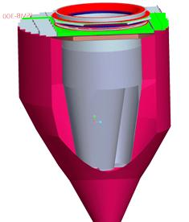
Cyclone Δp Reduction by Only Dip Tube Modification
New Improved GV (Guide vanes)
Ø 3900mm
Advantages
Reduction of pressure loss by up to 40%
Energy savings through reduced power requirement at the fan
Optimised utilisation of the plant inventory
Easy to retrofit (installation)
Reliable operation up to 750°C
Low investment required for increased production
Satna Cement Works
Stage 3 Cyclone
50% DP reduction achieved

Slide 10
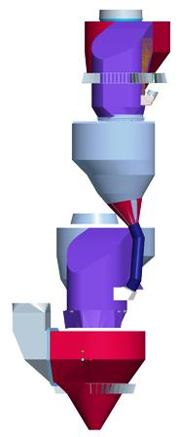
Pyro Process Modification
Tailor-made optimisation concepts
Optimisation of an existing cyclone preheater requires a tailor-made system solution.
When re-engineering one or more cyclone stages, the effects of and on the complete pyro must be considered
What we do
Optimization of all Cyclone Preheater Stages
Redesign of Calciner
What we can help achieve
Production increase with lesser system downtime and significantly less investment
Reduction of pressure loss/ Higher performance without change of pressure loss
Improved collecting efficiency
Increase in capacity
Best utilization of existing plant & structure
Improved energy savings
Improved separation performance and thermal efficiency
Satna Cement Works Modification
2nd ,3rd,4th , 5thCyclone& Calciner.
Prod. Increased 3300-4400 TPD

Slide 11
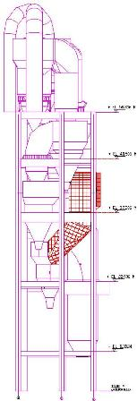
Calciner Redesign
For Alternate Fuel Firing and Lower NOx generation
Upgrade existing Calciners
More residence time and intensive mixing ,call for tailor-made solutions.
Customised mixing chambers for ideal reaction conditions
Special solutions for increased volumes in restricted spaces
Design and redesign of all types of Calciners
The special secondary firing concept of an integrated combustion chamber enables an implementation of favourable technical process solutions, even under difficult structural conditions.
Gujarat Siddhi Cement : Calciner RT from 2.5 to 4.5 sec. (capacity increased from 3800 to 4500 TPD)

Slide 12
KILN INLET CHAMBER MODIFICATION
Advantages
Reduce coating formation
Minimize reentrainment of feed back to the preheater circuit.
Reduction of pressure drop
Better breathing of the kiln
Redesign of Kiln Inlet Chamber for CMCL
Year: 2016
Note: All the above results contributes to energy saving, which varies from plant to plant and it can be computed.

Slide 13
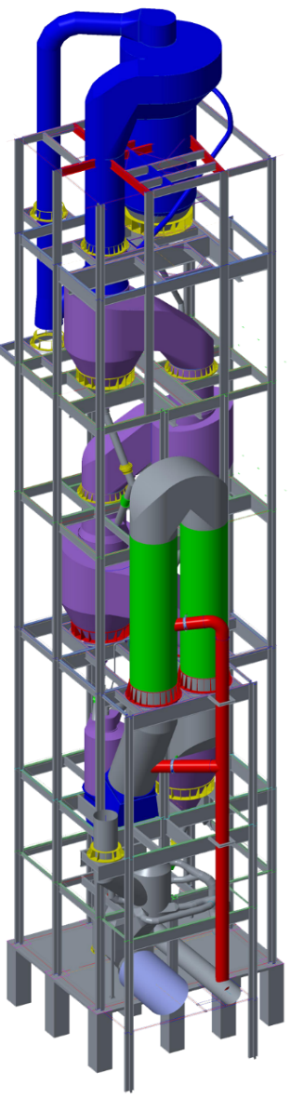
CALCINER REDESIGN
For Alternate Fuel Firing and Lower NOx generation
Upgrade Existing Calciners
Increased residence time and intensive mixing, call for tailor-made solutions.
Customised Mixing Chambers for ideal reaction conditions
Special solutions for increased volumes in restricted spaces
Design and Re-design of all types of Calciners
The special secondary firing concept of an integrated combustion chamber enables an implementation of favourable technical process solutions, even under difficult structural conditions.
Calciner Re-design at Gujarat Siddhi Cement Limited (Mehta Group)
Resident Time increased from 2.5 Seconds to 4.5 Seconds

Slide 14
Other Services
Kiln plant audit / Bottleneck analysis/ Reengineering /grinding/ classification
Evaluating thermal efficiency of kilns on the basis of calculated plant parameters
Determining cyclone potential for energy saving and clinker production increase
Kiln mechanical work
Optimal Design of Venting system.
Alternate Fuel firing complete solution.
Designing of SNCR & SCR systems to reduce NOx below the government new emission norms.

Slide 15
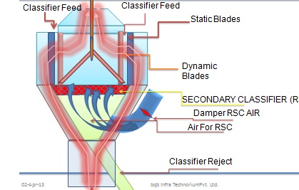
Separation Technology
4th Generation |“Secondary Separation”
β4G Ultracut ^{(TM)} Classifier high performance classifier from Reject cone
The β4G classifier is equipped with the static and dynamic vane technology similar to the 3rd gen Classifier. Blades are aero dynamically designed for lower resistance and therefore lower power and lower wear.
4th Generation Classifier:(added secondary classification)
Secondary Separation from the Reject Cone by measured circulating air and separation device in the cone.
This technology has been applied in Europe.

Slide 16



Flexibility of 3rd Generation Upgradation
Classifier Feed
Classifier Feed
Case Study of a New Generation Classifier for Cement Mill Installed 3 years ago in India.
Static Blades
Dynamic Blades
Note that higher % of -45µ, a fine product, is going back to the mill for regrinding.
Classifier Reject

Slide 17




Flexibility of 3rd Generation Upgradation
Classifier Feed
Classifier Feed
Static Blades
Dynamic Blades
Secondary Classifier (SCRC)
Damper SCRC AIR
Air For SCRC
Classifier Reject

Slide 18
A Typical Case Projection
Existing Classifier Efficiency Enhancement
WHAT
SCRC (Secondary Classification in Return Cone)
WHY (SCRC came into picture?)
Product fineness of cement has increased from 2800 - 3200 Blain to 3600 -4400 Blain ( true for PPC and slag cement contributing to >65/70% plant capacity)
While it is possible to produce cement with higher fineness ( 3700 to 4400 Blain) with the latest 3rd Generation Classifiers from any OEM, but the major loss in this process of classification is the % of -45µ that goes back to the mill for regrinding, which in turn reduces Classifier efficiency.
CASE – Cement Mill of AN INDIAN CEMENT PLANT
SIEVE ANALYSIS OF EXISTING MILL CIRCUIT SAMPLE
 | WITHOUT SCRC |  |  |  | WITH SCRC
 | +90µ | +45µ | -45µ | BLAIN | +90µ | +45µ | -45µ | BLAIN
PRODUCT | 2.9% | 12.5% | 87.50% | 3630 | 3.2% | 18.0% | 82.00% | 3630
OUTLET | 15.1% | 55.6% | 44.40% | 1800 | 24.2% | 55.2% | 44.80% | 1800
REJECT | 41.1% | 75.4% | 24.60% |  | 48.2% | 85.1% | 21.00%
CLASSIFIER EFF. |  |  | 62% |  |  |  | 71%

Slide 19
A Typical Case Projection
Results
PRODUCTION INCREASE
Secondary classification at the return cone - to recoup the maximum particles
-45µ should not go back to the mill for further grinding
REDUCTION IN SP. POWER
SCRC will bring down the Sp. Power Consumption by ≥0.56 kWh/T of Cement
Parameters | Existing | With SCRC
FEED TPH | 75 | 76.91
Flyash (%) in Feed | 27% | 27%
Gypsum (%) in Feed | 3% | 3%
Clinker (%) in Feed | 70% | 70%
kWh of Mill | 1690 | 1690
Sp. Power of Mill | 22.54 | 21.97

Slide 20
A Typical Case Projection - Results
RETURN ON INVESTMENT:
ROI ranges between 65% to 125%.
 |  |  | EXISTING FEED MIX
 |  |  | Mill #1
 |  |  | FEED | 75 | TPH
 |  |  | Flyash | 27% | 20.25
 |  |  | Gypsum | 3% | 2.1
 |  |  | Clinker | 70% | 52.65
 |  |  | TPH |  | 75
 | WITH SECONDARY CLASSIFICATION IN RETURN CONE
 |  | CIR. LOAD | Return Line | Mill Vent | Reject | -45µ in reject | Recuperation
 | % | 175% |  | 8% |  | 24.60% | 15%
 | TPH | 131.25 | 56.25 | 4.28571 | 51.9643 | 12.78321 | 1.917482143
1. | Total Recuperated quantity per day |  |  |  |  | = | 40.267125 | Tones/day
 | (@21 running hours per day)
2. | Therefore, Total recuperated quantity per annum |  |  |  |  | = | 12,482.81 | Tones/annum
 | (@310 running days per annum)
3. | Saving by production increase per annum |  |  |  |  | = | $ 176,643.52 | USD/annum
 | (@ $14.15/Tone realization cost of cement)

Slide 21
References
PLANT MODIFICATION/ENGINEERING/SUPPLY
Sl. No. | PLANT | COMPANY | COUNTRY | YEAR | PROJECTS | Remarks
1. | Lafarge Egypt | Holcim | Egypt | 2014 | Engineering, Design and Supply of Cement Cooler to bring down the temperature of oil well cement from 130 degC to 70 degC. Scope also includes the design & supply of cement silo and bulk loading system | Project on going
2. | Birla White | Ultratech Cement Limited | INDIA | 2014 | Supply of 2 units (1 left turning & 1 right turning) of Spare Guide Vanes (Dia. 1060 mm).
3. | Satna Cement Works | Birla Corporation India Pvt. Ltd. | INDIA | 2012 | Supply of Guide Vanes (Dia. 3900mm) for stage 3 and modification of Cyclones and Pre-Calciner for production increase. | Reduction in pressure drop achieved in result by ≥50% .
4. | Arghakhanchi Cement |  | Nepal | 2012 | Design, Engineering and Supply of Kiln Shell and Special Design of Kiln Chairpads. | Supply and Erection

Slide 22
References
PLANT MODIFICATION/ENGINEERING/SUPPLY
Sl. No. | PLANT | COMPANY | COUNTRY | YEAR | PROJECTS | Remarks
5. | Satna Cement Works | Birla Corporation India Pvt. Ltd. | INDIA | 2010 | Design and modification of Preheater 3rd Stage Cyclone. Production increased by 150 TPD. | Implemented and running well
6. | Satna Cement Works | Birla Corporation India Pvt. Ltd. | INDIA | 2010 | Detailed engineering and manufacturing drawing supply for New Coal Mill VRM. | Implemented and running well
7. | Satna Cement Works | Birla Corporation India Pvt. Ltd. | INDIA | 2010 | Cyclone design for preheater stage 3 supplied to SCW implemented by FLS. | Implemented and running well
8. | Gujarat Sidhi Cement | The Mehta Group | INDIA | 2010 | Pyro Process Modification for production increase from 3800 to 4800 TPD. | implemented and running well
9. | Saurashtra Cement | The Mehta Group | INDIA | 2010 | Pyro Process Modification. | implemented and running well

Slide 23
References
PLANT MODIFICATION/ENGINEERING/SUPPLY
Sl. No. | PLANT | COMPANY | COUNTRY | YEAR | PROJECTS | Remarks
10. | Satna Cement Works | Birla Corporation India Pvt. Ltd. | INDIA | 2007 | Supply of Guide Vane in Preheater Stage 2. Cyclone and riser duct modification & production increase in stage 4 (Cyclone Dia. 9 mts) and stage 5. | implemented and running well. Design and Concept by Mr. Debasis Bera
11. | Ultratech | Birla White | INDIA | 2006 | Preheater Top Stage Re-Designing | Design and Concept by Mr. Debasis Bera
12. | Chanderia Cement Works | Birla Corporation India Pvt. Ltd. | INDIA | 2007 | Complete Preheater & Calciner Modification for a production level of 4300 TPD | Design and Concept by Mr. Debasis Bera
13. | Ding Gao | Lafarge | China | 2006 | Calciner Modification | Design and Concept by Mr. Debasis Bera
14. | Assiut Cement | CEMEX | Egypt | 2005 | LINE-III: All cyclone and calciner modification for production increase from 3600 TPD to 4300 TPD. LINE-II: All cyclone and calciner modification for production increase from 3600 TPD to 4300 TPD.

Slide 24
References
PLANT MODIFICATION/ENGINEERING/SUPPLY
Sl. No. | PLANT | COMPANY | COUNTRY | YEAR | PROJECTS | Remarks
15. | Pakland Cement | DEWAN HATTAR | Pakistan | 2005 | Complete plant upgradation from 1600 TPD to 3200 TPD. The plant was in package but was installed with re-engineering to acieve 3200 TPD for GAS, OIL & COAL FIRE. | Design and Concept by Mr. Debasis Bera
16. | Cement Grasic | CEMEX | Indonasia | 2004 | Preheater Modification for capacity increase from 7400 TPD to 9300 TPD
17. | Green Island Cement | Green Island Group, Hong Kong | China | 2003 | All cyclones modification for production increase.

Slide 25
References
PLANT DETAILED TECHNICAL ANALYSIS/AUDIT/CONSULTING
Sl. No. | PLANT | COMPANY | COUNTRY | YEAR | PROJECTS | Remarks
1. | Port Elizabath | PPC Ltd. | South Africa | 2014 | Detailed Plant Analysis for Raw Material Grinding, Venting System, Pyro Process, Finish Mill and Coal Mill for plant capacity enhancement from 550 TPD to 900 TPD. | Via ERCOM
2. | Line SK8 | PPC Ltd. | South Africa | 2013/2014 | Detailed Plant Analysis for Raw Material Grinding, Venting System, Pyro Process and Coal Mill for plant capacity enhancement from 2250 TPD to 5000 TPD.
3. | Hirmi Cement Works | Ultratech Cement Ltd | INDIA | 2014 | Cement Mill Audit for reduction of Power Consumption
4. | Ambuja Cement | Holcim (Ambuja) | INDIA | 2012 | Detailed pyro process study and proposal for pyro process upgradation.
5. | Arghakhanchi Cement Pvt. Ltd. |  | NEPAL | 2012 | Basic engineering done for pyro process.

Slide 26
References
PLANT DETAILED TECHNICAL ANALYSIS/AUDIT/CONSULTING
Sl. No. | PLANT | COMPANY | COUNTRY | YEAR | PROJECTS | Remarks
6. | Satna Cement Works | Birla Corporation India Pvt. Ltd. | INDIA | 2012 | To evaluate the reason for 300 TPD shortage in production. Plant was modified by FLS and was not operating at designed capacity.
7. | JK Lakshmi Cement |  | INDIA | 2011 | Pyro Process detailed study.
8. | Andhra Cement Ltd. | Jaiprakash Associated Ltd. | INDIA | 2010 | To check the pyro process upgrade design and failure of not reaching the 60% of target. Plant was designed to operate at 5500 TPD by IKN but wasn't running beyond 3000 TPD. | Design and Concept by Mr. Debasis Bera
9. | Poineer Cement |  | UAE | 2010 | Detailed Plant Study and proposal for Pyro Process upgradation

Slide 27
References
PLANT OPERATION & MAINTENANCE
Sl. No. | PLANT | COMPANY | COUNTRY | YEAR | PROJECTS | Remarks
1. | Arghakhanchi Cement |  | Nepal | 2012 | Operation & Maintenance of Plant. Plant was unoptimized and was not able to utilize more than 66% of designed 600 TPD capacity. After deputation of BQB personnel and taking care of design defects the same plant is running at a level of >700 TPD. | Plant running successfully.
2. | Pawan Cement Co. (P) Ltd. | Maharaja Cement Ltd. | INDIA | 2012 | Operation & Maintenance of Plant. Pawan Cement was in idle state since 1990. It was designed to operate at 500 TPD but was running at 60% efficiency level. Now it is running at designed capacity. | Plant running successfully.

Slide 28
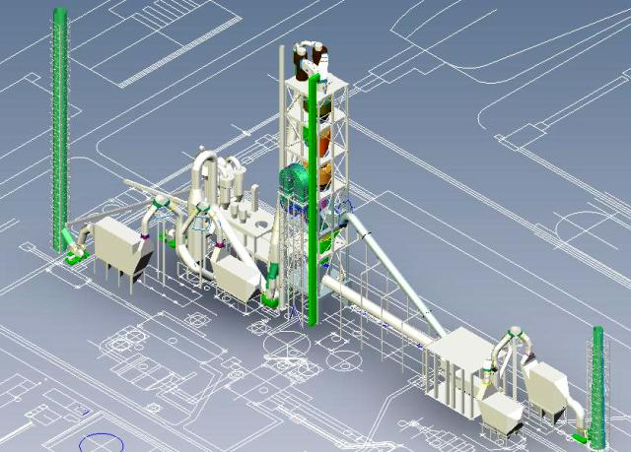
Case Study
A Complete Plant Upgrade
PAKLAND CEMENT, PAKISTAN
YEAR 2005
COMPLETE PLANT UPGRADE FROM 1600 TPD TO 3200 TPD (GAS, OIL AND COAL FIRED)

Slide 29
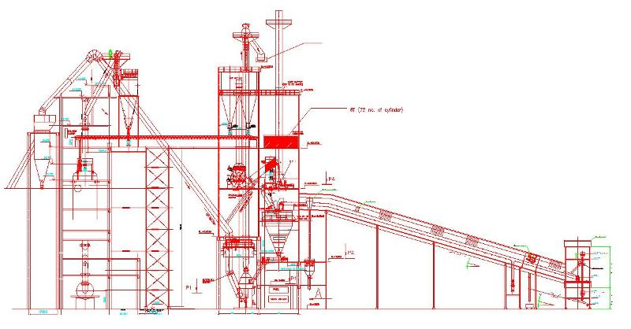
Case Study
Detailed Engineering of Coal Mill VRM
VRM Coal Mill (20TPH)
Satna Cement Works
Year- 2010
VRM was purchased from China, rest of the jobs (Engineering/Erection/Installation/Supervision) were done from BQB platform

Slide 30
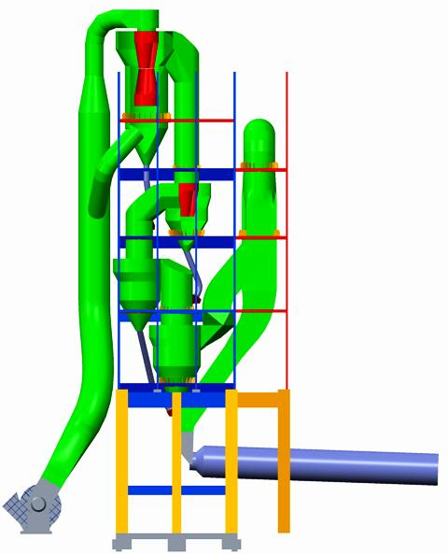
Case Study
Designing & Engineering for Plant Upgrade
PPC South Africa
Unit: SK8
Year: 2013
Design and Engineering for complete plant upgrade from 2200 TPD to 5000 TPD.

Slide 31
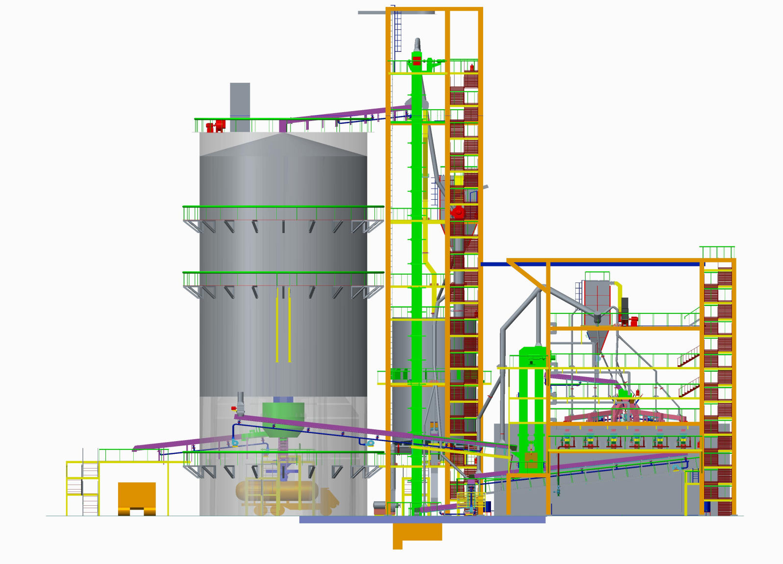

OUR RECENT INNOVATION
POWDER COOLER
Compact and highly efficient
Flexibility of operation and easy maintenance.
Complete design engineering and supply of cement silo, material handling , packing and bulk loading, complete electrical & instrumentation

Slide 32
OUR RECENT INNOVATION
Client: Gujrat Sidhee Cement Limited
Year: 2014
Lower 2 Stages (in both strings) cyclone modification to correct the temperature and collecting efficiency
Project was designed and implemented in a record time of 10 days!
Return Dust reduced by 3-4%
Reduction in PH outlet temperature: ≥20 degC

Slide 33
WHATS NEW WITH US !!!
Building Smarter Manufacturing With the Internet of Things (IoT)
Advantages:
Better than PLC and PC based controller & management system as these are largely disconnected from IT and Operational system
IoT would resolve the wiring issues by 80%.
We have experts with more than 10 years of experience in handling and developing IoT.

Slide 34
ALTERNATIVE FUEL
(Utilization of MSW (Municipal Solid Waste) in Cement Plant)

Slide 35
INTRODUCTION
Cement production is the second most energy consuming large scale industrial process.
Cement industry is an essential key factor in the waste management system for a safe and environmental friendly recycling of waste derived materials.
No negative influence on the properties of the cement and its application occurs.

Slide 36
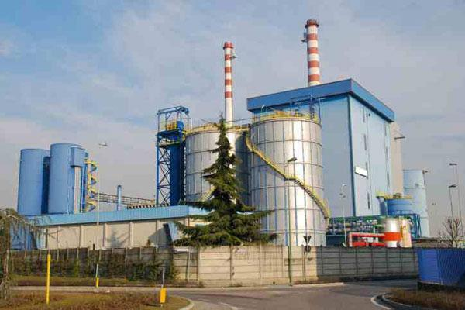
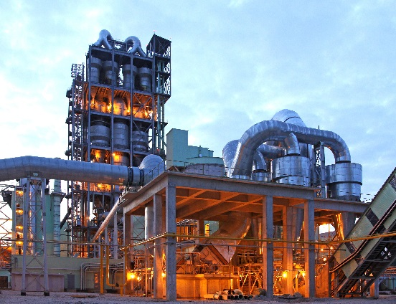
WASTE MATERIAL HANDLING
Waste material incineration
Co-processing in cement plant
Effective method to cater to waste and for power generation.
Incineration is expensive to the public as its having maximum number of unit operations.
Incineration plant should be replaced by recycling concept.
Its impossible to reduce the emission of gases( Dioxine, Furans and SOx, NOx) and residue ( Ash disposal, heavy metals)
Cost Efficient for the public
Environmental friendly solution with almost no emission of heavy metals, dioxine, furans, SOx, and NOx.
No influence on product(Clinker).
Saving of imported fossile fuel and reduction of CO2 emissions.

Slide 37
COMPARISON OF WASTE PROCESSING IN CEMENT PRODUCTION AND WASTE INCINERATION
 | Waste coprocessing in cement plant | Waste processing in the incineration plant
Saving of primary fuels (Coal, Gas, Oil) | 100 % substitution of primary fuel according to the calorific value of the waste | addition of primary fuel (oil or gas) necessary for ignition and complete combustion of the waste
An organical compounds of waste (ashes) | Ashes are completely recycled into the product clinker and cement | Ashes have to be processed or in most cases deposed in landfills
Heavy metal content of waste and related emissions | Due to the alkalinity of the process complete immobilization of heavy metals in the crystal structure of clinker (Except Mercury) | Heavy metals will be mainly evaporated and extremely expensive and complicated filtering and washing systems have to be installed.
Formation of dioxins and fuarans by chlorine and flourine compounds in the waste | Combustion at 1450 °c with Complete cracking of all Oranical compounds into the base molecule „methane“. Time window of denovosynthesis of dioxine neglectable. | combustion at appr. 850 °c with high retention time for complete combustion. time window for denovosynthsis of dioxins and furans high. after burning of waste gas sometimes necessary.
Transportation of Waste | Cement plants are located at the source of limestone. Transportation is necessary | waste incineration plants are installed at the source of the waste.

Slide 38
CLASSIFICATION OF WASTE DERIVED MATERIAL
Waste Derived Material
Non Re-generatable material
Re-generatable material
Industrial Waste
Solid
Electrical Waste
Waste plastic
Crating material
Tire/Tire chips
Liquid
Used lubricants
Photo chemical waste
Municipal waste
Solid
Plastic waste
Sewage sludge
Food rests
Agricultural Waste
Solid
Wood chips
Saw dust
Agricultural husks
Raps oil resins
Animal and bone meal
Liquid
Sun flower oil rests
Raps oil
Gaseous
Bio gas
Composition gas

Slide 39
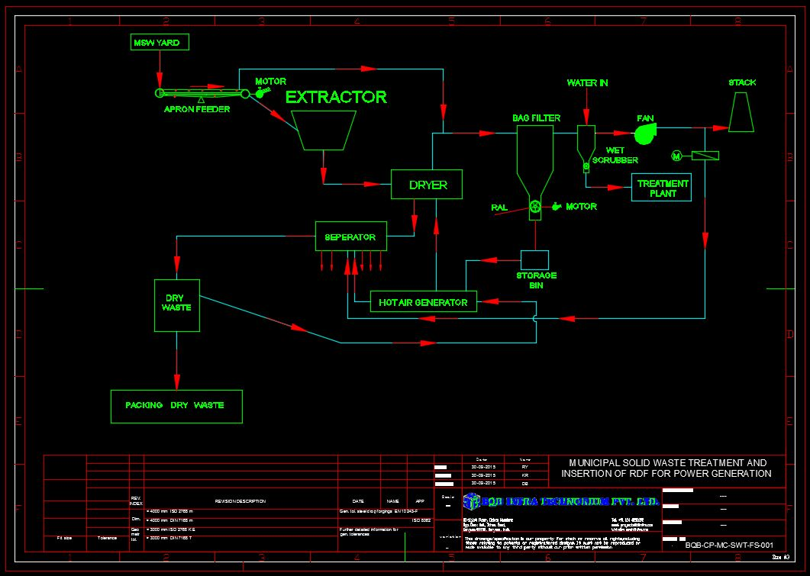
FLOW SHEET- PREPARATION OF MSW

Slide 40
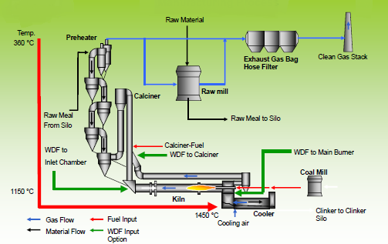
COPROCESSING OF RDF IN CLINKER MANUFACTURING PROCESS

Slide 41
SCOPE OF BQB
(In association with Leading European companies)
Techno-commercial feasibility study the current operation philosophy and assessing the bottlenecks.
Cooperating with local waste management systems, industrial and communities
Design and installation of Preparation, Handling, Dosing and Feeding technology
Suggestion to improve the combustion in calciner.
Suggestion to control the emissions like heavy metals, Dioxine furans, SOx, NOx and CO2.

Slide 42






Our Associates
EURO KILNS
ALL KIND OF KILN MECH. WORKS

Slide 43
THANK YOU

