Slide 1
NOx
SOx
NOx
REDUCTION OF NOx & SOx EMISSION
WITH ALTERNATIVE FUEL UTILIZATION
IN CEMENT INDUSTRY

Slide 2
FOCUS AREA
Aim of this presentation is to focus on following:
    Reduction and Control of NOx
    Reduction and Control of SOx

Slide 3
NEW EMISSION NORMS
Notification No. GSR 612 (E) dated 25.08.2014

Slide 4
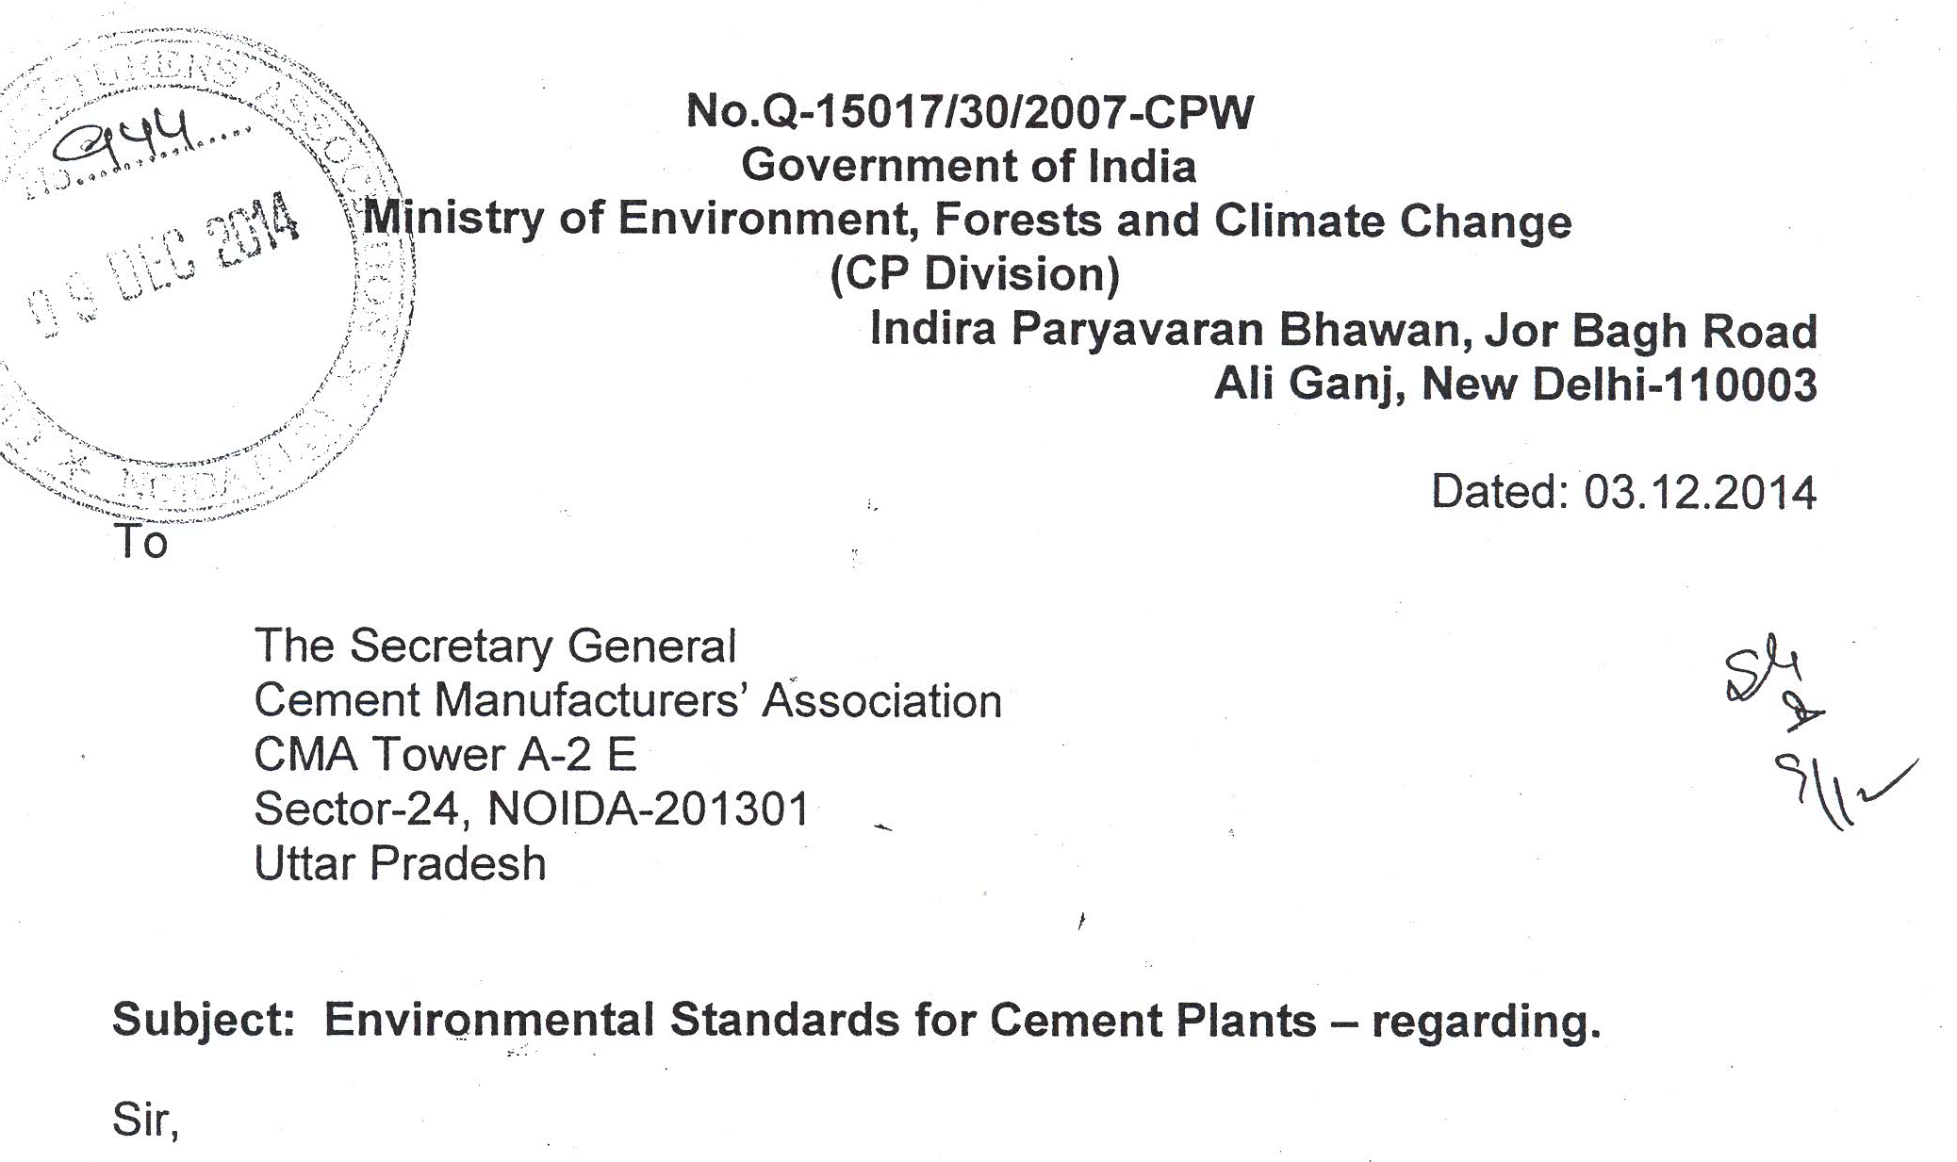
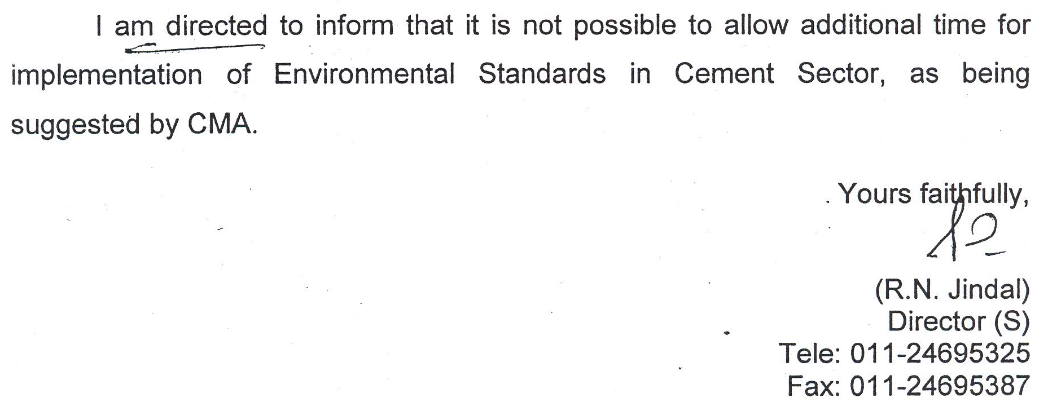
NEW EMISSION NORMS
Notification No. GSR 612 (E) dated 25.08.2014

Slide 5
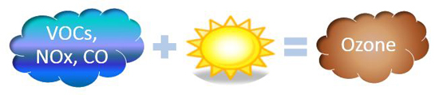
HOW NOx AFFECT US ??
Air is mixture of different gases, mainly 78% N2 and 20.8% O2 ( N2 is remain inert in normal temp.)
NOx is formed during high temperature combustion in presence of excess O2. NOx emission contributes to the formation of fine particles and ozone smog that cost society billions of dollars annually from illnesses and deaths.
Nitrogen oxides eventually form nitric acid when dissolved in atmospheric moisture, forming a component of acid rain . This chemical reaction occurs when nitrogen dioxide reacts with water:
2 NO₂ + H₂O → HNO₂ + HNO₃

Slide 6
MAJOR SOURCES OF NOx IN CEMENT PLANTS
  Feed NOx : Very minor to no contribution
  Thermal NOx : Created by reaction of N2 and O2 in air at Temperatures >1300 degC (i.e. - Kiln)
  Fuel NOx : Formed in Calciner by combustion of N-atom in fuel

Slide 7
THERMAL NOx FORMATION
NOx formed in the high-temperature environment in the burning zone of a kiln is “thermal NOx” at the range 1200-1600°C . Thermal NOx is formed by oxidation of atmospheric nitrogen at high temperatures.
Since the flame temperature in a kiln is significantly above these temperatures, considerable amounts of thermal NO are generated in the burning zone. The thermal reaction between oxygen and nitrogen is simplified as follows:
O2 + 2N2 → 2NO + 2N
N + O2 → NO + O
NO formation increases exponentially as temperature increases, and increases as excess oxygen (O2) increases. Above 1400°C, small changes in temperature produce large changes in concentrations of NO at a given oxygen concentration .
Gas temperatures in kiln burning zones are significantly above clinker material temperatures, which must reach about 1450°C to form some clinker compounds

Slide 8
FUEL NOx FORMATION
NOx can also result from oxidation of nitrogen compounds in fuel (Fuel NOx).
Fuel nitrogen is only partially converted into NO during combustion and this reaction occurs throughout the temperature range of the combustion process relatively independent of temperature
"N" + O → NO
"N" + NO → N2 + O
(Second Reaction is highly affected by Temperature)
800 to 1000 degC

Slide 9
EFFECT OF TEMPERATURE & EXCESS O2
ON FUEL NOx
Effect of Temperature
Effect of excess O2

Slide 10
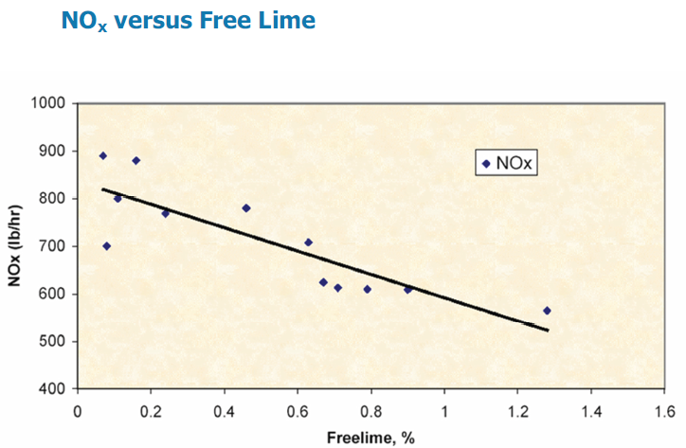
NOx versus Free Lime

Slide 11
NOx CONTROL STRATEGY
Process Optimization
Modifications / Hardware Change
Selective Catalytic & Non-Catalytic Reduction

Slide 12
PROCESS OPTIMIZATION
Reduce Clinkerization temperature in burning zone by proper raw mix design and optimization of flux
Combustion zone control of temperature and excess air through continuous monitoring
Kiln Fuel Type
Efficient Cooler Control
Optimization of Primary and conveying air at kiln Burner
Kiln inlet O2 control
Monitoring Free lime

Slide 13
MODIFICATIONS / HARDWARE CHANGE
Conversion from direct-fired coal systems to indirect systems to reduce primary air quantity .
Installation of a new burner (“low NOx” burner)
Reduction in the amount of excess air (oxygen) used for combustion.
Split the feed to calciner to create the hot Zone in the calciner immediately at coal firing point.
Split the tertiary air to reduce the oxygen % in Calciner.
Use “Low – NOx Calciners”. Calciner retrofit is possible for In Line Calciners.

Slide 14
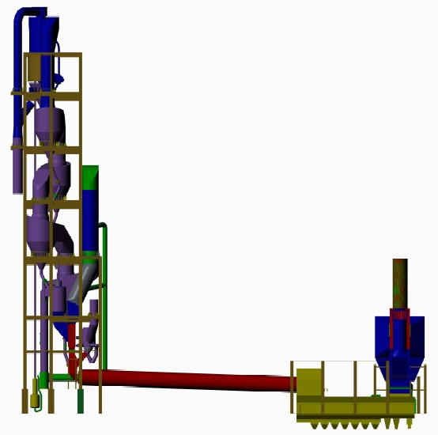
LOW NOx CALCINER
Enhanced resident time
Better Air & Fuel distribution
Alternative Fuel Utilization
Low NOx Calciner
Combustion Chamber
TAD Air Distribution
TAD

Slide 15
SELECTIVE NON-CATALYTIC REDUCTION
SNCR process is basically the injection of aqueous ammonia in flue gases at suitable temperature (Calciner)
A SNCR system’s performance depends on temperature, resident time, turbulence, oxygen content and number of factors specific to given gas stream into the Calciner.
Reactions when injecting NH3
If T = 950 ± 50°C
NH3 + OH → NH2 + H2O
NH2 + NO → N2 + H2O
NH3 + O2 → NO + H2O
(if T < 900°C)

Slide 16
SELECTIVE NON-CATALYTIC REDUCTION
N₂
H₂O
NH₃ Spray
NH3 Solution Tank
_{Calciner}
NOx
SNCR Valve Rack System

Slide 17
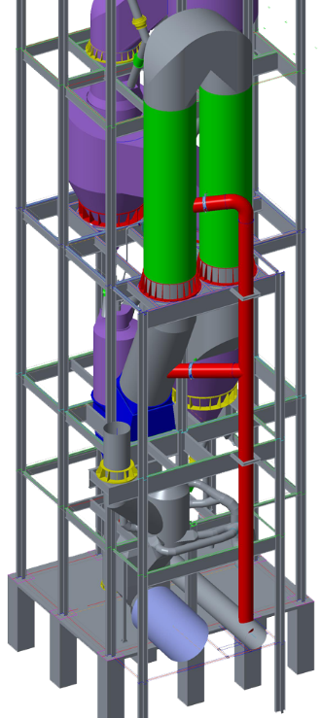
AMMONIA FIRING POINT IN CALCINER
Ammonia Injection Point

Slide 18
FACTORS AFFECTING SNCR OPERATIONAL COST
  Baseline NOx Level
  Desired Final NOx Level
  Local Market/Transportation Costs for Ammonia
  Ammonia Utilization

Slide 19
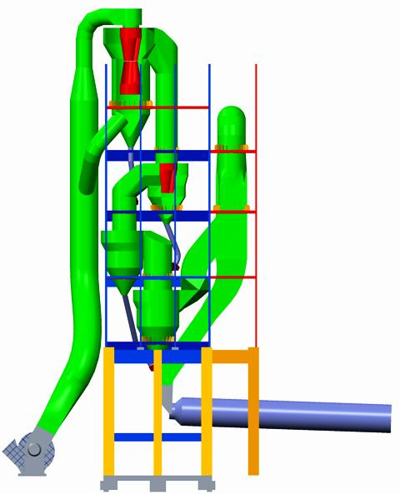
SO2 EMISSION
Primary source of SO2 Emissions:
Pyritic Sulfur in Raw Material
S + O2 → SO2
Reaction takes place in the temperature range
of 400 - 600°C

Slide 20
SULPHUR ABSORPTION
CaO + SO2 → CaSO3
CaCO3 + SO2 → CaSO3 + CO2

Slide 21
REAL TIME TESTING
FOR NOx REDUCTION AND CONTROL
Situation at every plant is different therefore, we recommend:
FIRST PHASE : Real Time Test
SECOND PHASE : Complete SNCR Installation

Slide 22
REAL TIME TESTING
FOR NOx REDUCTION AND CONTROL
WHAT WE DO FOR REAL TIME TEST ??
Specific study for controlling NOx on real time basis for 2 to 4 days with our Ready Portable SNCR System.
Continuous monitoring of NOx & SOx during the test.
Quantity of Aqueous Ammonia is continuously regulated and monitored.

Slide 23
TYPICAL CASE STUDY FOR SNCR OPEX
FOR A CEMENT PLANT WITH 5000 TPD CLINKER PRODUCTION CAPACITY
Existing NOx Level : 1150 mg/Nm³
Desired NOx Level : 750 mg/Nm³
Molar Ratio of Ammonia in Solution = 1.25 : 1 (25% ammonia)
Computed Ammonia consumption : 0.92 m³/hr.
Cost of ammonia considered : ₹ 10 / Litre
Cost of NH₃ Annually:
0.92 x 1000 x 24 x 10 x 330 = 728 Lac / Year
Cost/Ton of Clinker = 44.16 ₹ / Ton of Clinker
Ammonia consumption cost ≈ ₹ 44 / Ton of Clinker

Slide 24









COMPANIES WE HAVE WORKED WITH
Green Island Cement

Slide 25






OUR ASSOCIATES
EURO KILNS
ALL KIND OF KILN MECH. WORKS
CEMCON SWITZERLAND

Slide 26
THANK YOU

